Slide 1
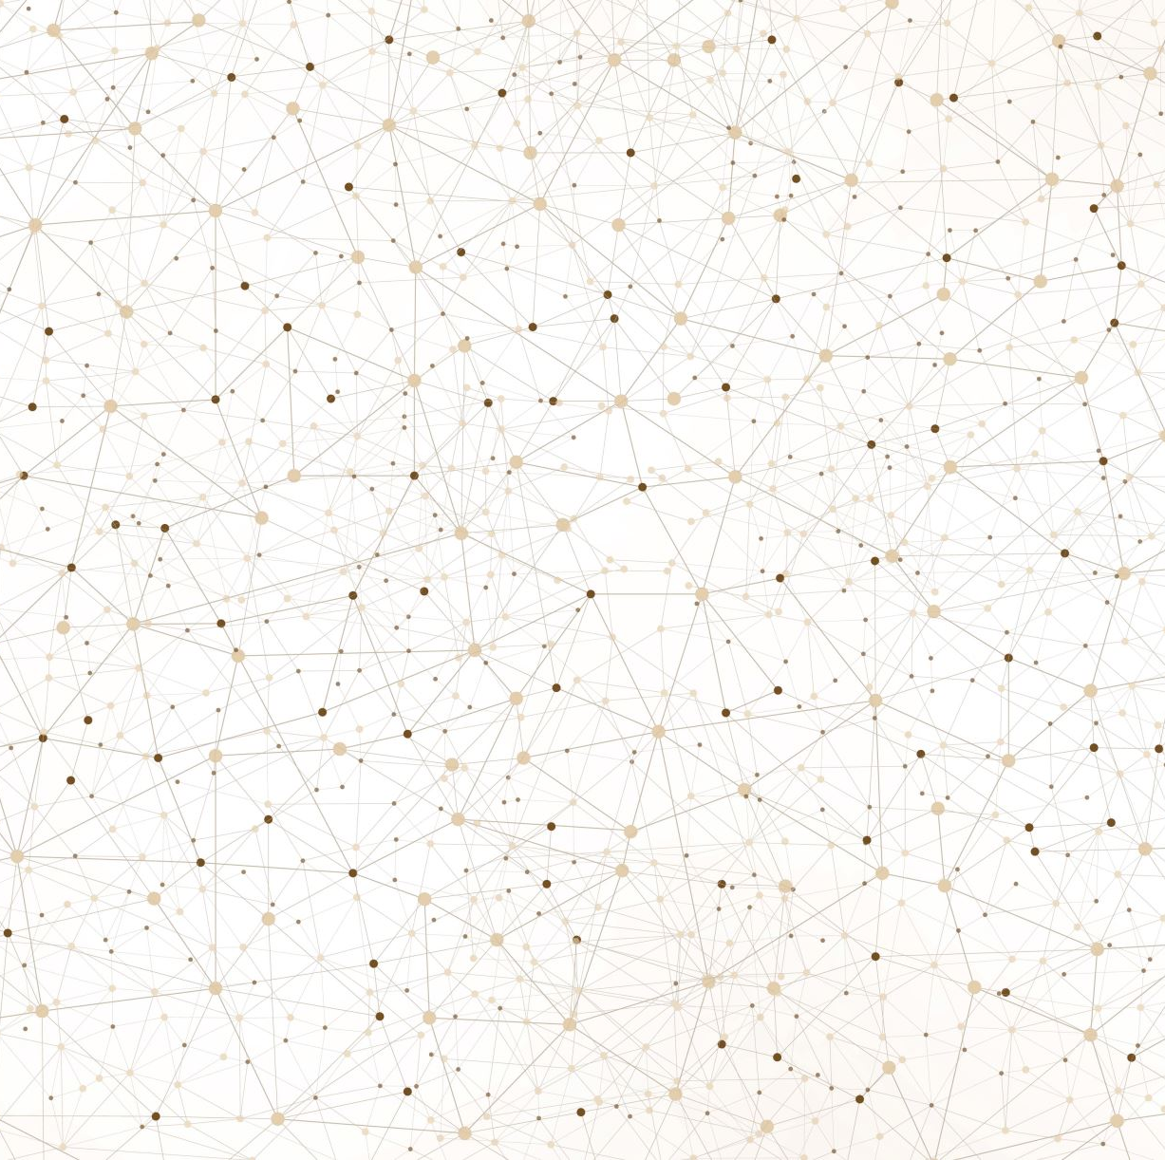
STUDY OF PERLIN NOISE AND ITS USE IN TERRAIN GENERATION
Parthiv Susarla- 22011102107

Slide 2
What is Perlin noise?
Perlin noise is a type of noise that generates random numbers that follow a smooth gradient. This means that if you sample the generator at two nearby points, you will get back two similar results. This makes Perlin noise ideal for generating terrain, as it can create smooth, natural-looking landscapes.
The Perlin noise algorithm works by first creating a grid of random numbers. These random numbers are then interpolated to create a smooth gradient. The gradient is then used to calculate the noise value at any given point.
Perlin noise is unique for terrain generation because it can create smooth, natural-looking landscapes.

Slide 3
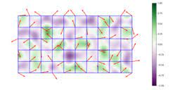
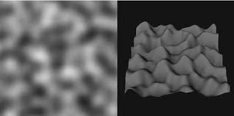
Application of Perlin noise:
Perlin noise has been used in many video games and other applications, including:
Terrain generation
Texture synthesis
Image processing
Fluid simulations
Smoke simulations
Fire simulations
Cloud simulations

Slide 4
Python for Perlin Noise
OpenSimplex is a Python package which can be used for procedural generation like texture synthesis or terrain generation.
'noise' library in Python provides an implementation of OpenSimplex function. We can easily generate a 2D noise map using it. The different parameters used are width, height, scale, octaves, persistence, lacunarity and seed.
NumPy can also be used to implement Perlin Noise and is a more flexible method which gives us more control over the parameters though more complex.

Slide 5
Java for Perlin Noise
For generating noise in Java, JNoise is a popular library. It can support 1D, 2D, 3D and 4D noise. It is lightweight and easy to use. It can be useful for various applications such as procedural content generation, terrain generation, and more.
Jnoise has a Generators.perlin() method which has different parameters like frequency, lacunarity, persistence and octaves, and we can generate a grid based on the x and y values we take.
We can also implement without any libraries but it makes the code more complex and difficult to understand.

Slide 6
Parameters for Noise generation
Octaves- Through this we can control the number of times the function is generated. Higher the octaves, more the detail but this can end up making it too noisy.
Frequency- Determines how quickly the noise value changes across space. Lower frequency results in slower changes and larger features.
Lacunarity- It determines how quickly the frequency increases as we move from one octave to the next. Smaller lacunarity results in smoother transition and higher lacunarity will make the noise have high frequency at each octave.
Persistence- This controls how much each octave contributes to the overall noise. A higher persistence will make the noise smoother and create finer details.

Slide 7
Parameters for Noise generation
Scale- Shows the size of the noise, higher the scale, larger the noise.
Seed- This is used to initialize the random generator to generate the gradient vectors and generates a random pattern for each seed.
Interpolation- The process of smoothly blending between the noise values at each lattice point. There are different methods like smoothstep, Hermite, linear interpolation etc.

